Slide 2


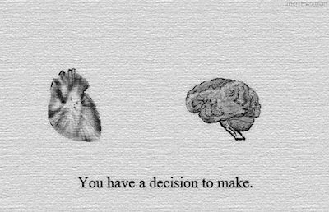
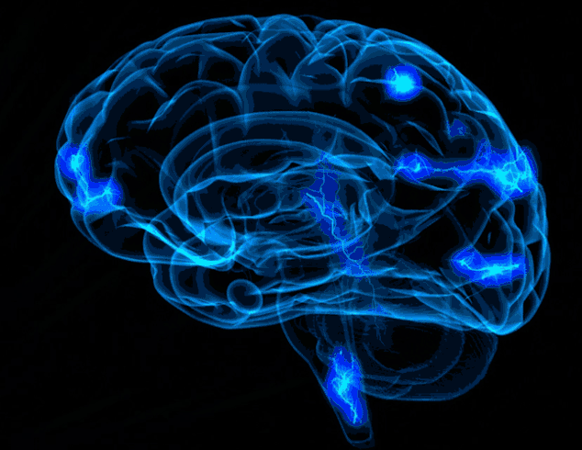


Unifying Neurobiological, Computational, Environmental, and Clinical Studies to Advance Developmental Research: A Multimethodological Approach
Cassondra (Cassie) Eng, PhD
Society for Research in Child Development 2023, Paper Symposium
Notes:
Hi everyone my name is Cassie Eng and I am a T32 Sports Neuroscience Postdoctoral Scholar at Stanford University in the School of Medicine in the CIBSR
Thank you so much for being here bright and early in the blizzard outside
I’m so excited to share with you today how we can synergize findings from computational, neurobiological, environmental, and clinical studies to advance our understanding of information processing across development through a multimethodological lens

Slide 3

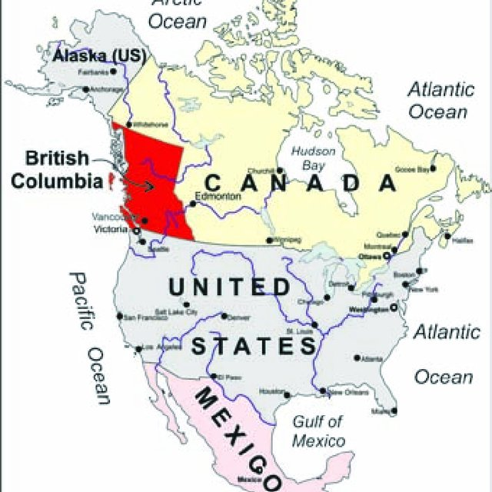

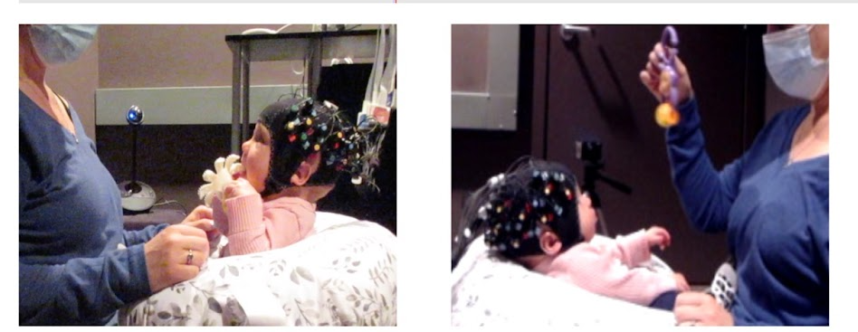
Dr. Aleksandra (Ola) Dopierala
Notes:
Our first speaker is Dr. Ola Dope-E-er-ah-wah. She is a postdoctoral scholar all the way from Canada at the University of British Columbia.
CLICK Her work focuses on processes from a neurobiological approach examining neural patterns with 5-to-7-month-old infants using functional near-infrared spectroscopy also known as fNIRS, and is the first study to validate NIRS in infancy as a methodological tool for measuring neural correlates of processes such as looking and attention in a naturalistic environment

Slide 4

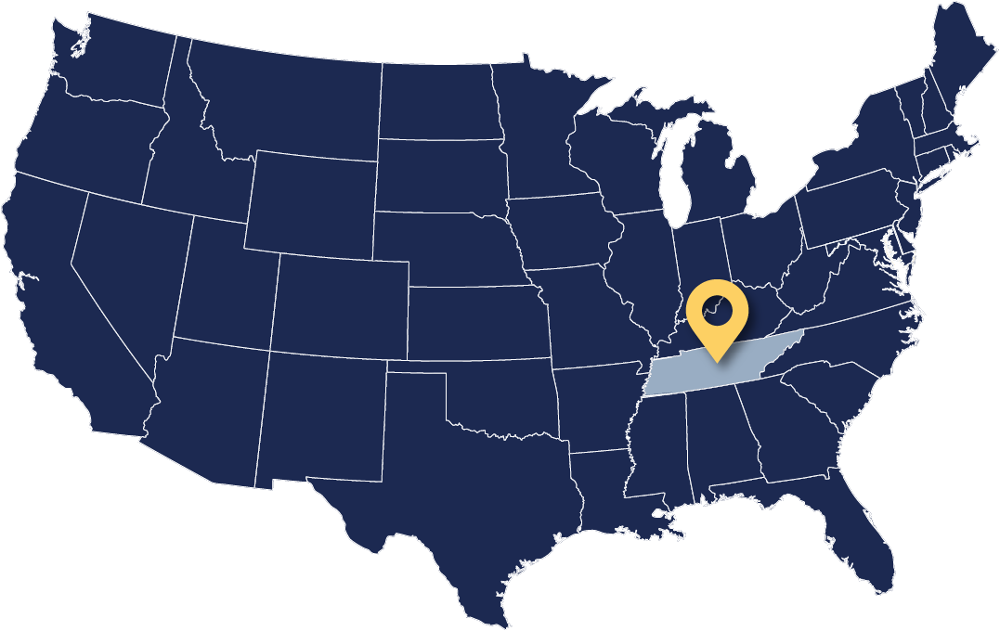
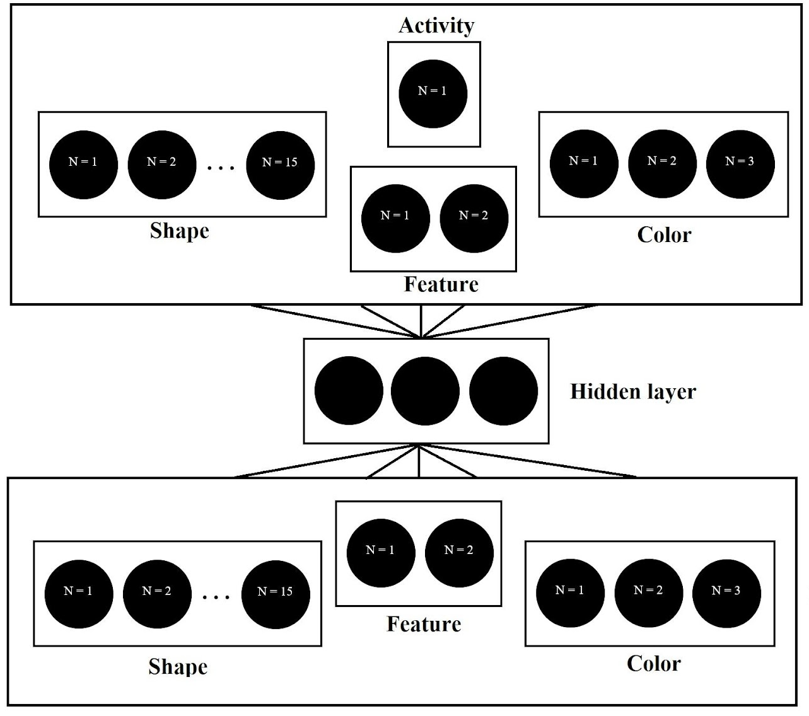
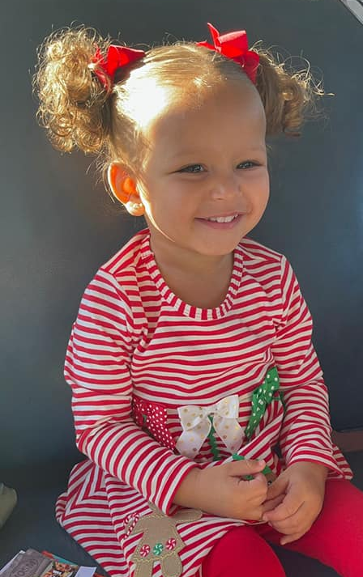

Dr. Deon Benton
Photos courtesy of Lindsey Benton
Notes:
Our second speaker is speaker is Dr. Deon Benton. He is a professor of psychology and human development all the way from Nashville Tennessee at Vanderbilt University.
Transitioning from infancy to toddlerhood, Deon’s work investigates processes with 2-and-3-year-old toddlers using a computational approach, with modeling work showing the ability to detect second-order correlations depends on having sufficient information-processing capacities
2 to 3 year old toddlers

Slide 5
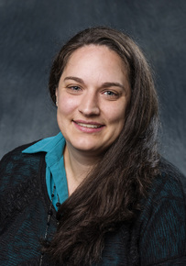




Dr. Gabrielle Strouse
Notes:
Our third speaker is speaker is Dr. Gabrielle Strouse. She is a Professor of Counseling & Psychology in Education all the way from the University of South Dakota
CLICK Transitioning from toddlerhood to preschoolers, Gabrielle’s work is timely and focuses on dyadic processes such as joint-visual-attention during shared book reading with 3-to-5-year-olds in varying video chat contexts from an environmental approach

Slide 6

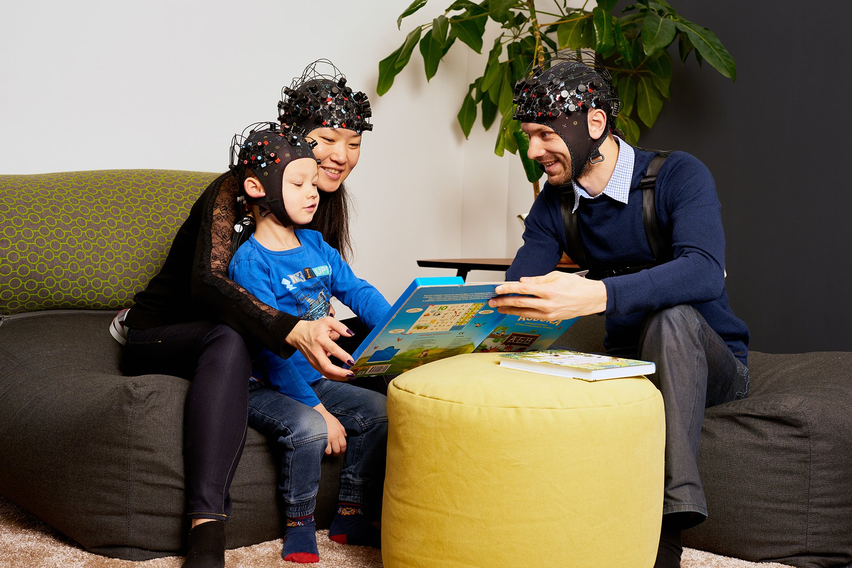
Clinical Approach: predicting behavior with brain patterns using fNIRS and looking behavior in girls with Fragile X Syndrome during dyadic interactions
Notes:
Finally,
CLICK transitioning from preschoolers to middle childhood, I am going to briefly discuss how we can encompass all methodologies from the three presentations with neuroimaging using fNIRS–identical to the neurobiological approach in Ola’s study, a model to predict outcomes–mirroring the computational aligned with Deon’s work, and future work understanding processes in dyadic interactions in varying contexts–following the environmental approach in Gabrielle’s line of work with a population of girls with Fragile X syndrome, from a clinical appraoch.

Slide 8
Unifying Neurobiological, Computational, Environmental, and Clinical Studies to Advance Developmental Research: A Multimethodological Approach
Cassondra (Cassie) Eng, PhD
Society for Research in Child Development 2023, Paper Symposium
Notes:
Now I am going to briefly discuss how we can encompass all methodologies from the three presentations you just saw from a clinical approach

Slide 9
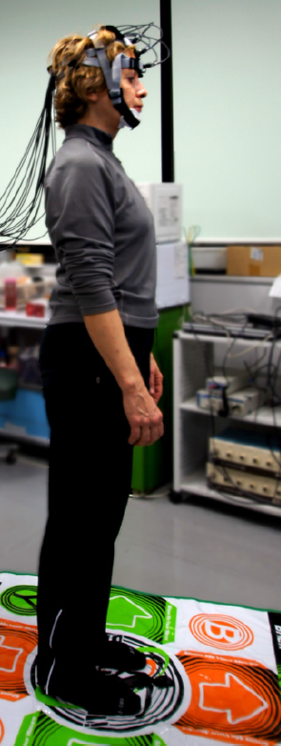
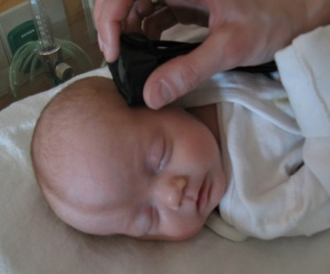
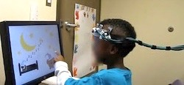
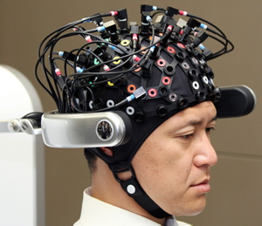
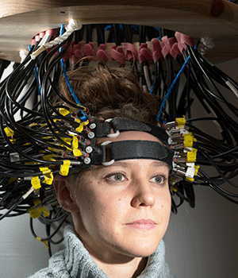
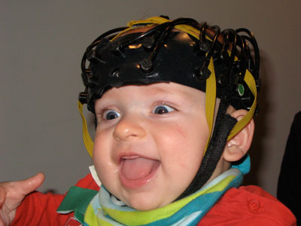
Neurological Approach: fNIRS
Measures cerebral hemodynamic responses and changes in hemoglobin concentration via imaging the brain with near-infrared light
fNIRS has emerged as a safe, non-invasive, flexible technology complementary to other brain imaging and monitoring modalities.
Notes:
First I’m going to briefly discuss the neurological methodology from Ola’s presentation
fNIRS measures changes in blood hemoglobin concentration by imaging the brain with low-levels of light
Blood replenishes oxygen to neurons, so similar to fMRI, changes in blood flow are used as a proxy for neural activity

Slide 10
Advantages of fNIRS
1. non-invasive
2. does not require participants to remain immobile
3. not confined to a small space and loud environment
4. less sensitive to motion artifacts
5. relatively portable and inexpensive
(Ono & Eggebrecht, 2019)
Notes:
This technique revolutionized the field because
its non-invasive
Doesn’t require children to remain still and in a confined environment such as fMRI
And its less sensitive to motion artifacts like EEG
So it’s very useful for neuroimaging research with children
CLICK And it’s use is growing so you’ll see the published articles have doubled since a decade ago

Slide 11
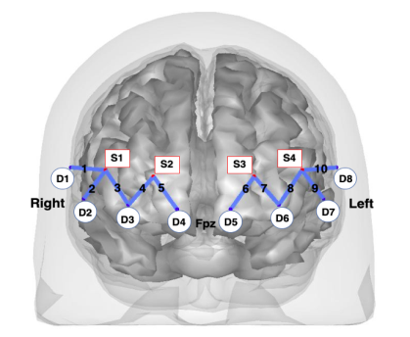
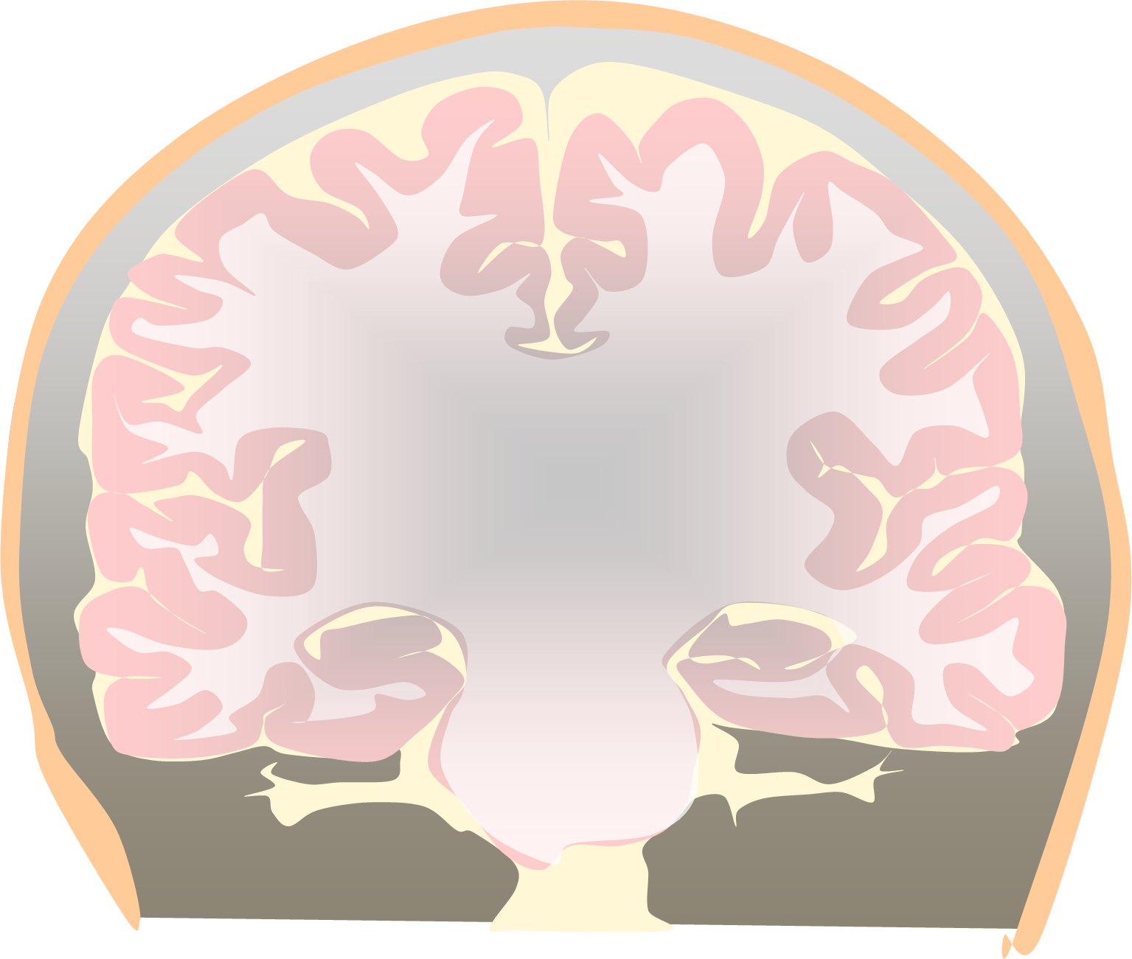
How fNIRS uses light to image the brain
Light Source
Pulse Oximetry
Detector
Light source
Detector
Scalp
Skull
CSF
Brain
Anterior View of example fNIRS montage referenced to 10-20 EEG coordinate system covering areas Fp1-F8 on the Prefrontal Cortex
Adapted from Dr. David Boas fNIRS Training Course,
Boston University Neurophotonics Center
Notes:
fNIRS uses the same technology as pulse oximeters which most of you have probably seen at doctor’s offices
CLICK and the way pulse oximetry works is there’s a light source that emits the light
CLICK and a detector that detects that light
CLICK leading to a channel that can measure hemoglobin concentration in the blood
CLICK fNIRS was first used in the medical field in 1977 when Frans Jobsis proved that near-infrared light can CLICK
CLICK penetrate through the skull and biological tissues to the cortex
CLICK This diagram shows an example layout of an fNIRS montage covering the prefrontal cortex
But instead of one light source like the pulse oximeter, there are
CLICK 4 light sources and CLICK 8 detectors to give oxygenation measures in 10 channels represented by the blue lines on the prefrontal cortex
In 1977 Minolta Corporation marketed the first commercial pulse oximeter: Oximet MET 1471 (Yoshiya, 1980).
In 1977 Frans F. Jöbsis proved that near-infrared light penetrates deep into biological tissues (Jobsis, 1977).
In 1989 David Delpy in collaboration with Hamamatsu developed the first commercial NIRS system: NIR-1000 Cerebral Oxygenation Monitor.

Slide 12

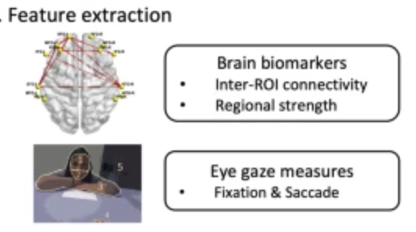
Clinical Approach: Neural patterns and looking behavior in girls with Fragile X Syndrome
Fragile X syndrome (FXS): genetic disorder among the most common heritable risk factors for intellectual disability and ASD, affecting ~1 in 4000 males and 1 in 7000 females worldwide
Computational approach:
Dr. Rihui (Eric) Li
University of Macau
Professor of the Center for Cognitive & Brain Sciences
42 girls ages 10-11 with FXS and an age and IQ matched control group
Brain activity at the frontal cortex and less eye contact during a naturalistic conversation predicted FXS-linked symptom severity
Notes:
This is work led by my close colleague Dr. Eric Li, a fellow T32 postdoctoral fellow in my program at Stanford who is now recently faculty at university of Macau in China
caused by changes in a gene called Fragile X Messenger Ribonucleoprotein 1 (FMR1). FMR1 usually makes a protein called FMRP that is needed for brain development
We implemented a machine learning-based approach to predict social-cognitive behaviors in girls with FXS and found that Brain activity at the frontal cortex and less eye contact during a naturalistic conversation predicted FXS-linked symptom severity
Each conversation condition consisted of eight 1-minute blocks with a 10 s inter-block interval. A female researcher who was novel to the participants began the conversation by querying the participant about a topic known (from parental report) to be of interest followed with additional topics (e.g., school, family) standardized across all participants. The first conversation condition was a “non-prompt” condition during which conversation flowed in a natural way for eight 1-minute blocks
The predictive model for each domain of behaviors was implemented in a two-layer framework (Fig. 2). On the first layer, each individual biomarker was used independently to train a support vector regression (SVR) model with an RBF (Radial Basis Function) kernel for predicting the participants’ behavior scores (Fig. 2A, B). Pearson’s correlation coefficient was calculated between the predicted scores and target scores for each single input biomarker, which represented the importance of each biomarker in predicting the target scores. We then sorted the correlation coefficients obtained from all biomarkers in a descending manner (Fig. 2B), from which biomarkers that demonstrated significant correlations between the predicted scores and the target scores were selected as input features for the second layer of the model. The second layer used a random forest (RF) regression model to predict the behavior scores with the pre-selected multi-dimensional features (Fig. 2C). Here we randomly split the entire data set into a training set (n = 25) and a testing set (n = 10). The training set was used to train the regression models. For each domain of behavior, parameters of the predictive model were tuned individually. The prediction performance of each model was assessed by calculating the Pearson’s correlation coefficient between the predicted scores from the testing set and corresponding target scores. In addition, we used an iterative permutation-based approach to assess the importance of each feature in the final predictive model

Slide 13
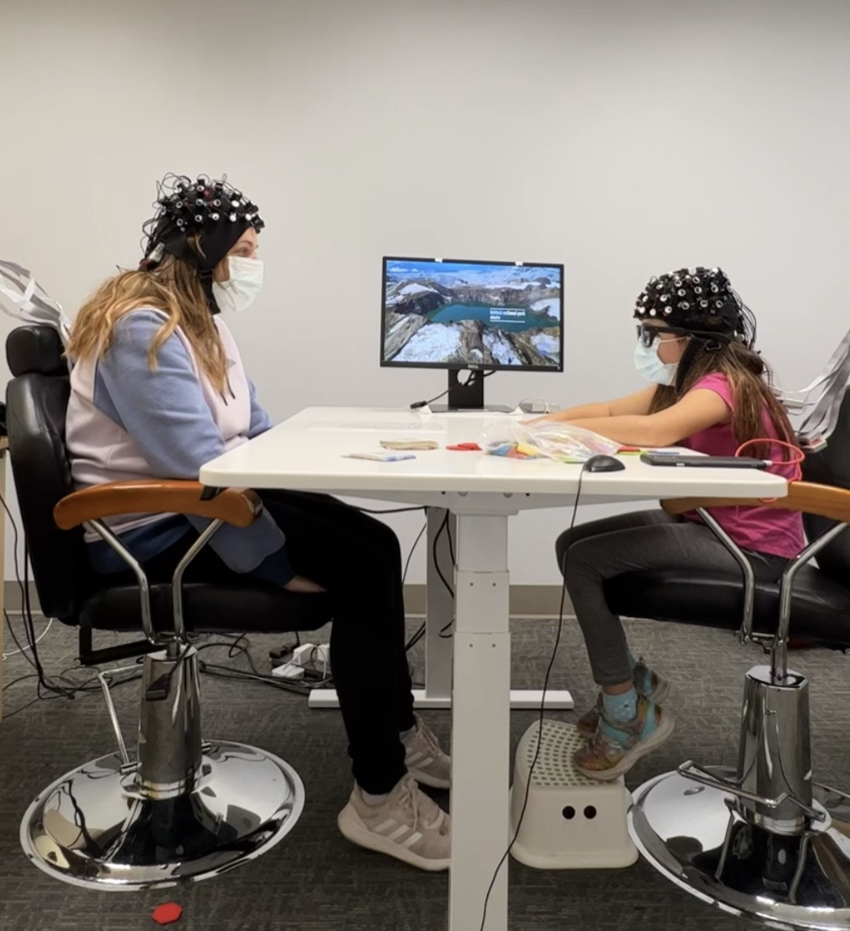
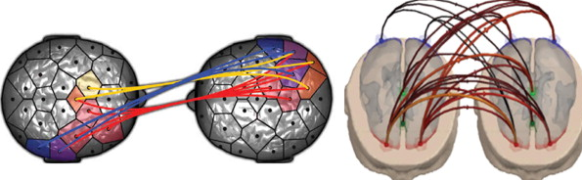
Environmental Approach: Hyperscanning Dyads in Varying Contexts
Can neural synchrony in child-parent dyads serve as a promising biomarker for prospective FXS-linked symptom severity?
Notes:
Following Gabrielle’s line of work currently we are collecting data during dyadic interactions in varying contexts using hyperscannning with NIRS, that is, SIMULATANEOUS NEUROIMAING DATA COLLECTION TO examine NEURAL synchrony IN DYADS
We know from prior research in the lab that there is higher neural synchrony between dyads in-person over video chat
We’re interested in the neural patterns not just within a fragile X group compared to a matched control group, but also whether the neural synchrony in dyads can serve as a promising biomarker for prospective FXS-linked symptom severity

Slide 14

CLINICAL
ENVIRONMENTAL
COMPUTATIONAL
NEUROLOGICAL
Technology as a supplement to foster cognitive development
Elucidate information processing
mechanisms across development
Notes:
Sometimes areas within developmental psychology are viewed as siloed: social, neurological, environmental, computational… but today what you saw were
CLICK findings from studies employing multiple methodologies can converge and advance our understanding of information processing across development
Early information processing predicts later educational/occupational outcomes and overall wellbeing; therefore, harmonizing methodological approaches in diverse developmental contexts provides a promising avenue for future research.

Slide 15
Dr. Ola Dopierala
Dr. Deon Benton
Dr. Gabrielle Strouse
Notes:
Finally I would like to thank our speakers and open the audience up to questions

